Slide 1

The Easy Alternative to Citrix
DISCOVER
2022

Slide 2



SECURE
Access Your Windows Apps from Any Device, at Any Time
2
10
EFFORTLESS
Don’t Spend Time and Money Using Citrix.
Maximize your IT infrastructure investment!
ECONOMIC

Slide 3
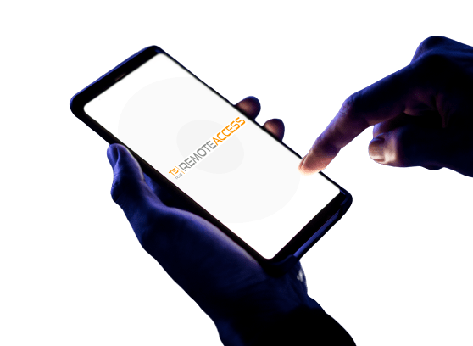

Publish Your Apps on
The Web in a Snap
3
Enable Users to Connect and Work from Anywhere
10
Remote Desktop Access
Application Delivery
Web Application Portal
Universal Printer
Lite Mode VS Expert Mode

Slide 4
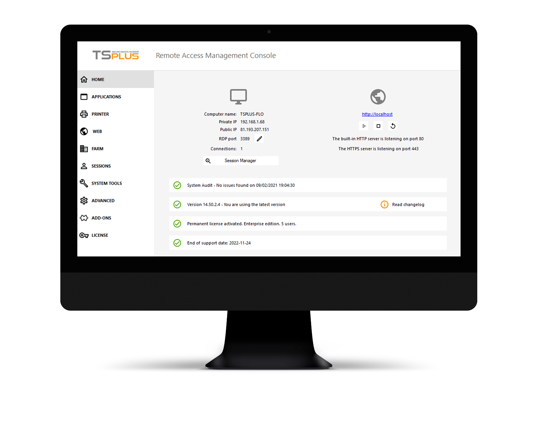
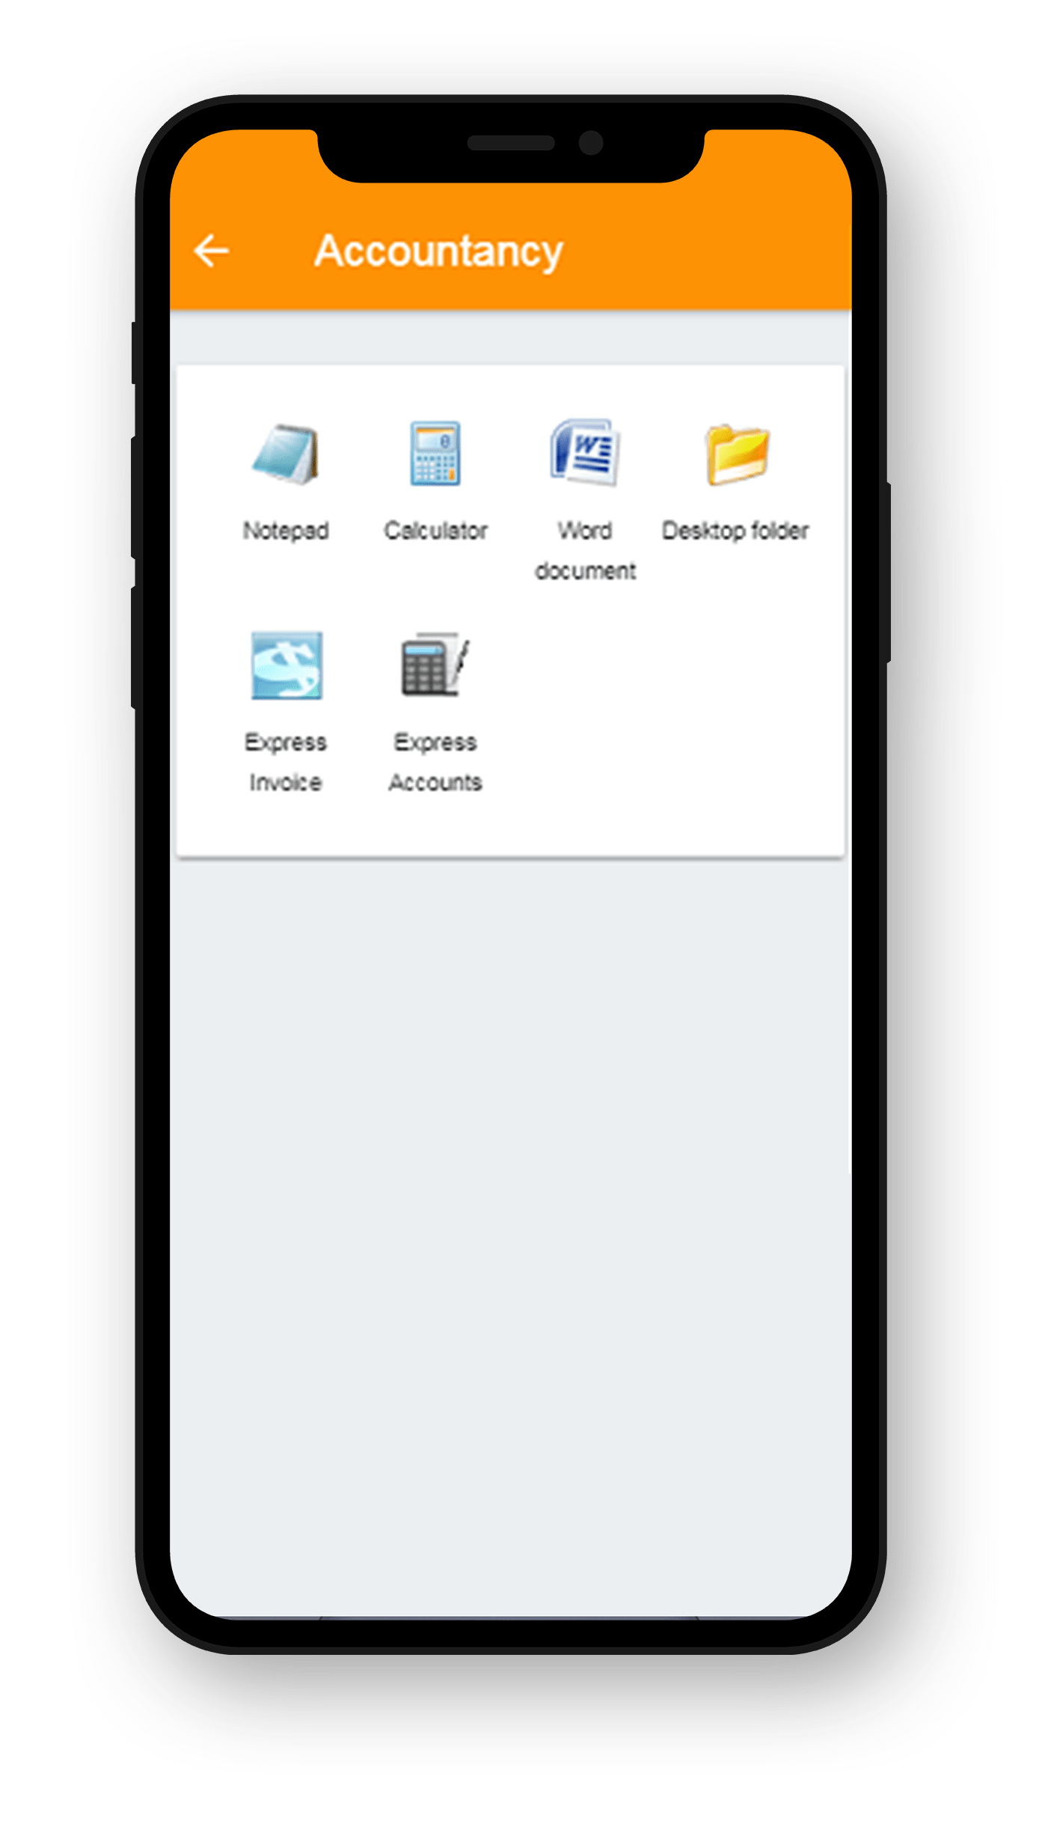
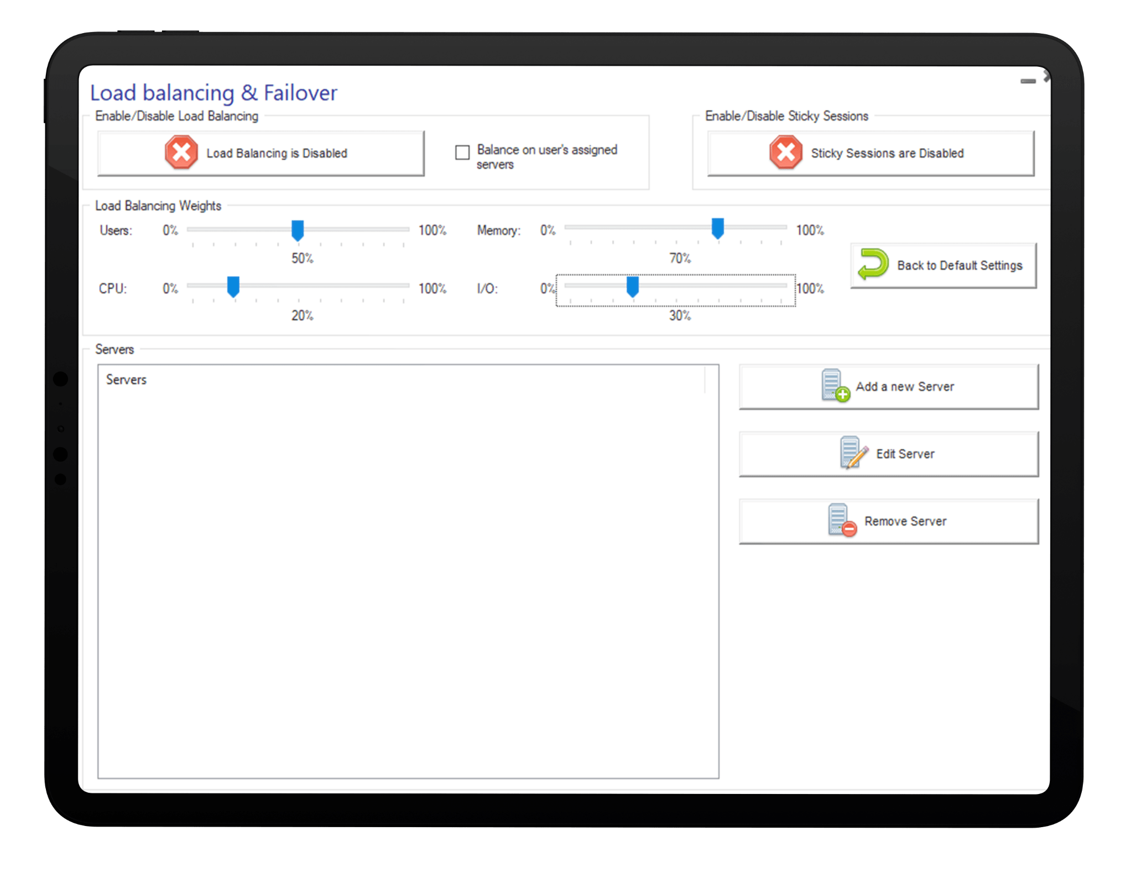
Get Setup Quickly with our Simple and Powerful Remote Access Solution
Configure and Manage Your Network From One Place
4
10
Quick installation
Easy setup
Portable Client Generator
Flexible Network Configuration

Slide 5
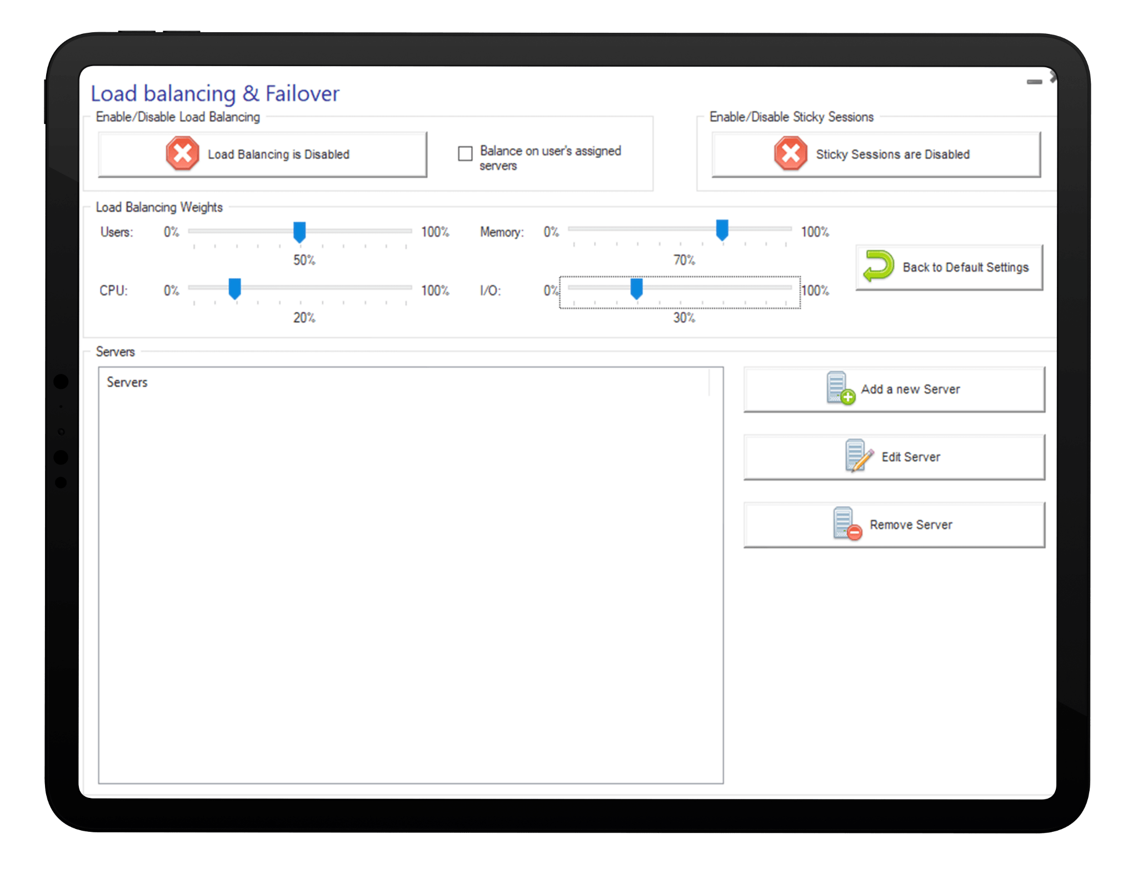
Get Setup Quickly with our Simple and Powerful Remote Access Solution
Configure and Manage Your Network From One Place
4
10
SMART MANAGEMENT
Intuitive AdminTool
Application Control per Groups
Single Enterprise Portal

Slide 6
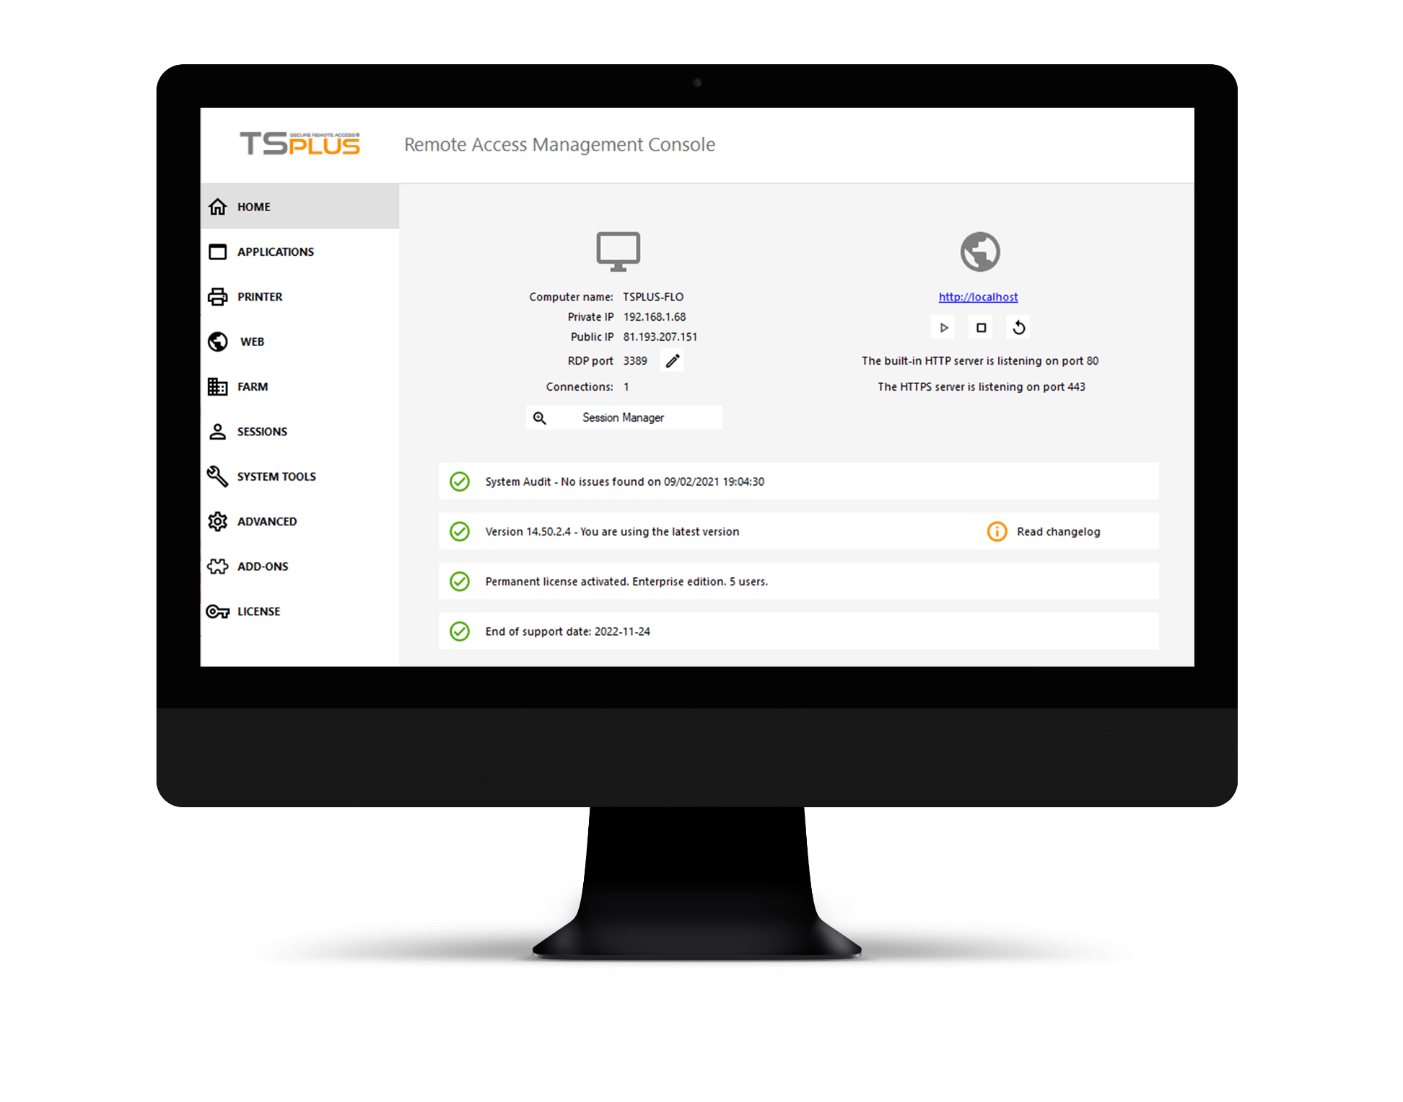
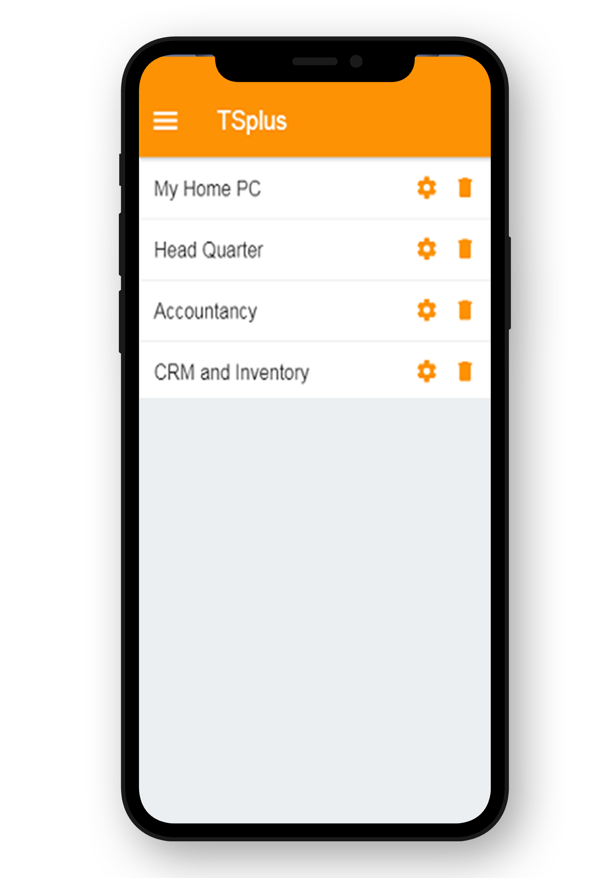
Get Setup Quickly with our Simple and Powerful Remote Access Solution
Configure and Manage Your Network From One Place
4
10
SCALABLE TO YOUR NEEDS
Load-balancing
Server Farm Management
Bundles: 3 editions & 4 add-ons

Slide 7
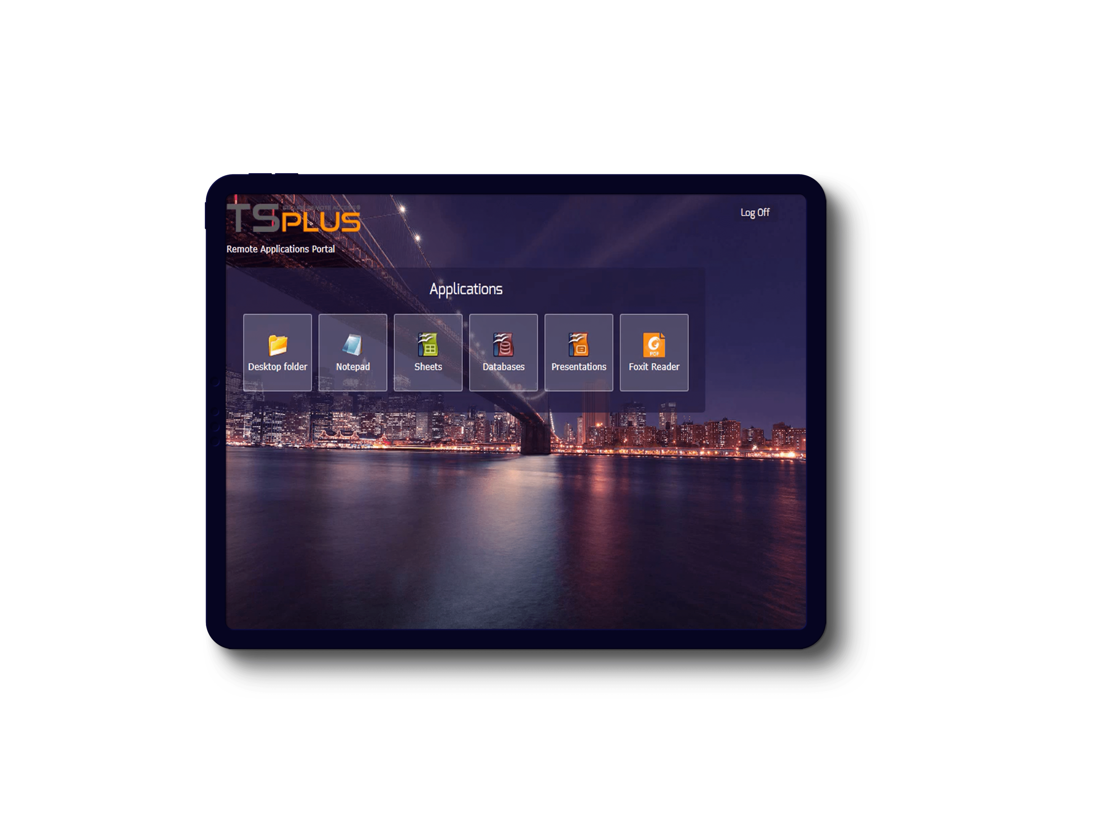
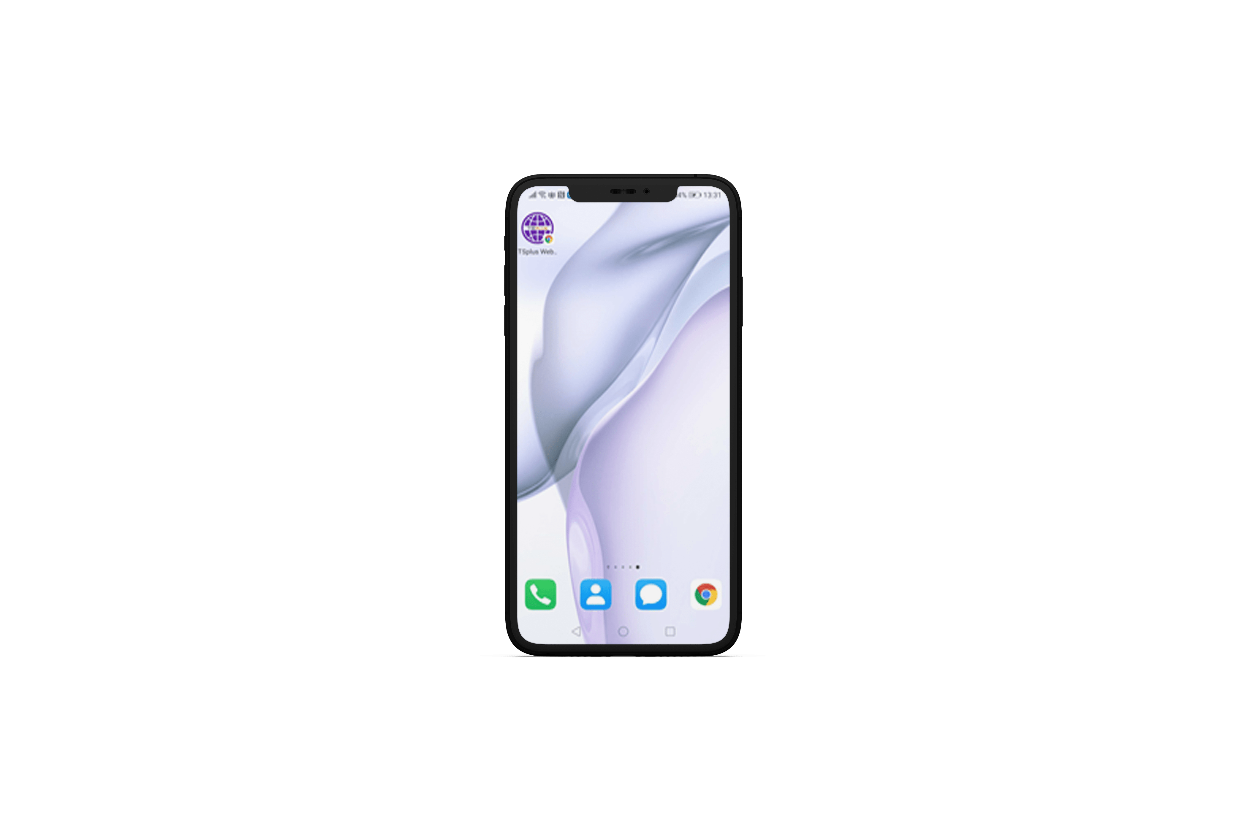
Easily Create The Optimal Remote Environment for Your Business
Give Your Users the Flexibility They Need
1
ACCESSIBILITY
Use Remote Desktop or Seamless Clients
5
2
TOOLS
Display a Full Desktop or a Single App
10
3
LOOK-AND -FEEL
Choose the Remote Taskbar, Floating Panel or Open-On-Client
4
MOBILITY
Install the Web App on Any Browser, Any Device
5
CONNECTIVITY
Compatible with Any Windows OS, Linux or Mac machine

Slide 8
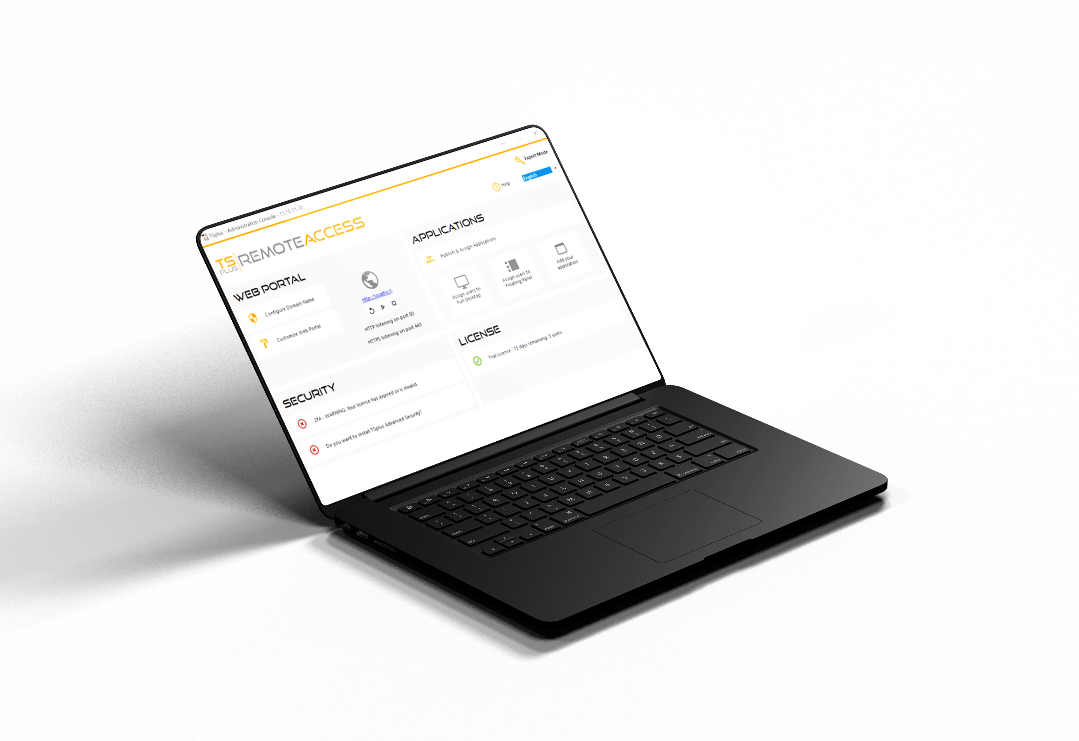
Remote Access is New For You? Get a Quick Start with Our Lite Mode
All our best features, right where you need them
6
1
CUSTOMIZE YOUR WEB PORTAL
Webmaster Toolkit
10
2
PUBLISH YOUR FAVORITE APPLICATIONS
Per User or Group
3
ELEVATE YOUR SECURITY
With our security add-ons
4
CHECK AND UPGRADE YOUR LICENSE
3 Editions To Grow With You

Slide 9


Make Remote Access
Safe for Everyone
No Third Party Servers. Keep Control of your Connections!
7
10
Built-in Web Server
SSL/TLS Certificate
End-to-End Encryption
Web Credentials
Security Add-ons

Slide 10


Corporate data center
or cloud server
The TSplus Difference:
A Built-In Web Server with HTML5 Client
8
Your business applications
installed on the central server
RDP and html5 clients
10
Host Your Apps On Your Central Server or Private Cloud for Top Security
Secure access for multiple users and devices

Slide 11
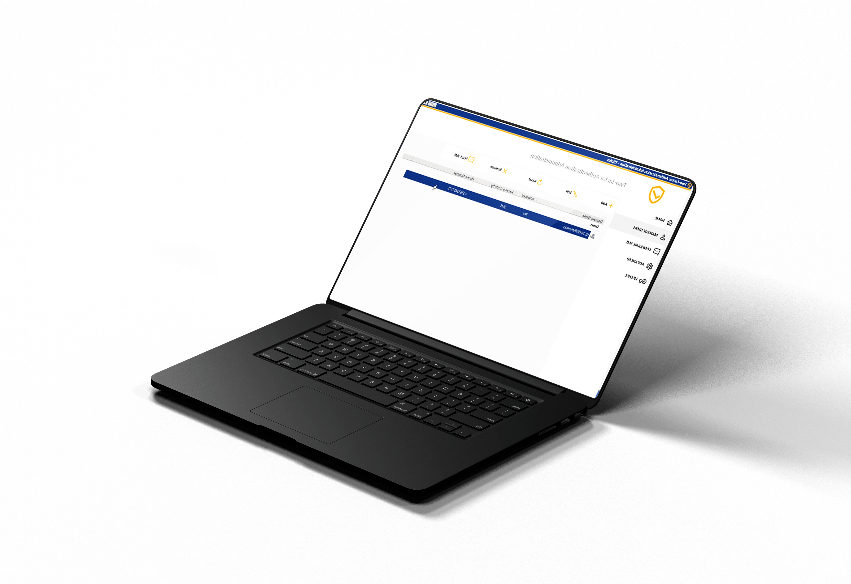
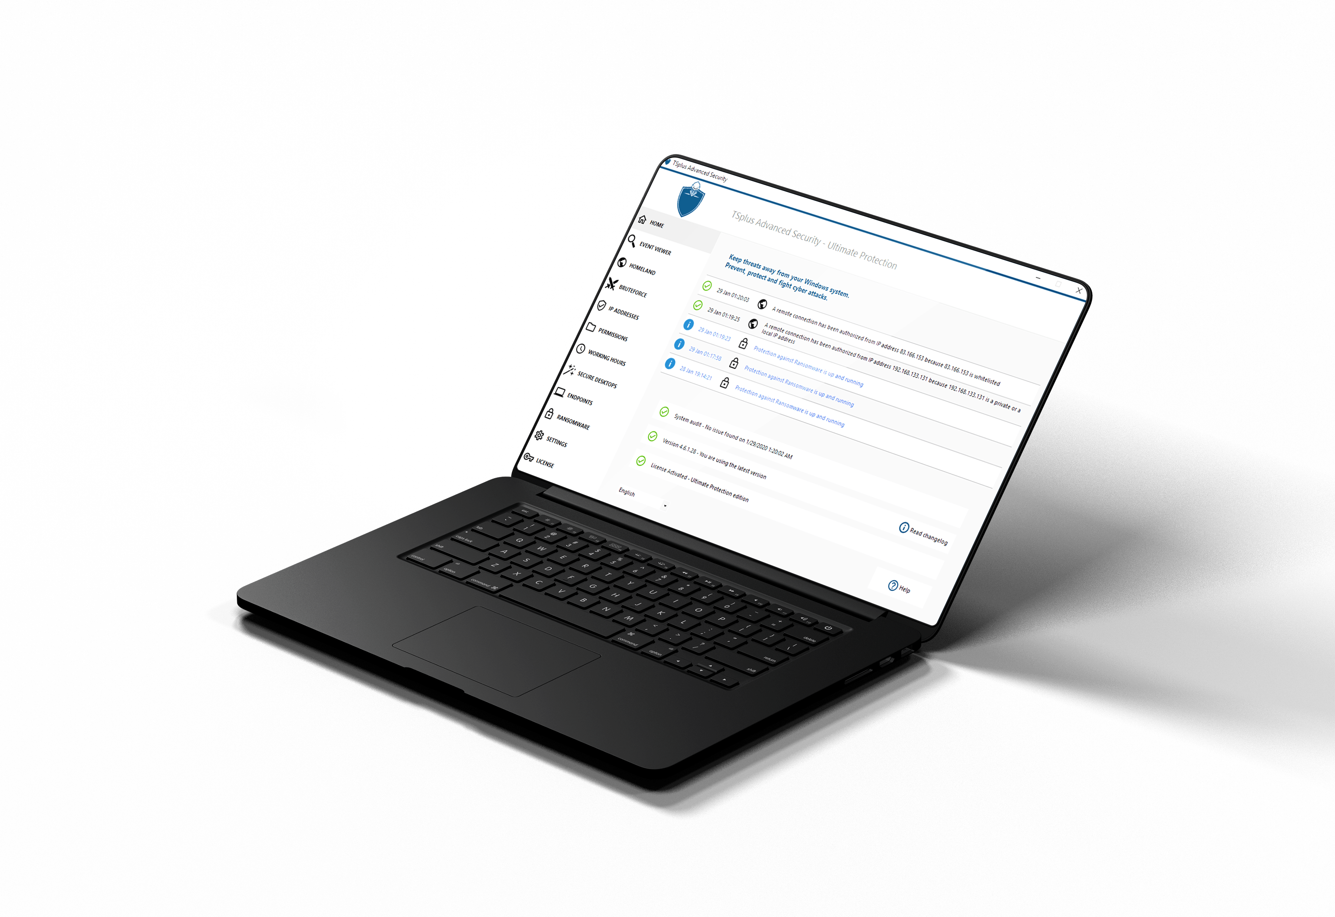

Fortify Your Network Security
TSplus Offers Robust Security Tools for Your Remote Access Network
9
10
An Extra Layer of Security for Your Web Portal
The Remote Desktop CYBER SECURITY Multi-tool
DISCOVER
DISCOVER

Slide 12

A Great Product Should not Come at a Great Cost. Be Smart and Take the Leap!
10
Our very attractive licensing model starts at:
PERPETUAL LICENSES
PER USER PRICING
FREE TRIAL DOWNLOAD
10
$90
for 3 users
Pay only once.
Support unlimited
15 days
Own the Licenses Forever!
Number of Devices Per User
Test it today!
Visit our website

